Slide 1

Diabetes Forecasting
Depi Project

Slide 2

outline
Introduction
Dataset exploration
Data preprocessing and cleaning
EDA
Scaling and Balancing
Modeling
Conclusion

Slide 3

Introduction
Diabetes is a chronic medical condition that affects how the body processes blood glucose (sugar)
Diabetes is global health concern with rising prevalence.
Early detection can improve treatment and reduce complications
In this project based on dataset will predict if the patient has diabetes or not

Slide 4
Data Exploration
Data shape is 100000 rows x 9 columns
Columns is:
Gender (Male, Female), Age, Hypertension (high blood pressure), Heart disease, smoking history(never, no info, current, former, ever, not current), BMI, HbA1c_level(Avg blood sugar over 2-3 months), blood glucose level, Diabetes(Target)

Slide 5
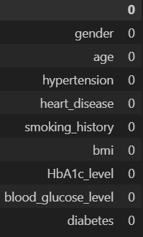
Data preprocessing and Cleaning
Check for missing values: there isn’t any.
We identified 3,854 duplicate rows in the dataset, which were removed to ensure data quality and avoid bias in model training.
Encoding :transforming categorical data into numerical (Gender, Smoking history columns) using label encoder that encodes each value starting from 1.

Slide 6
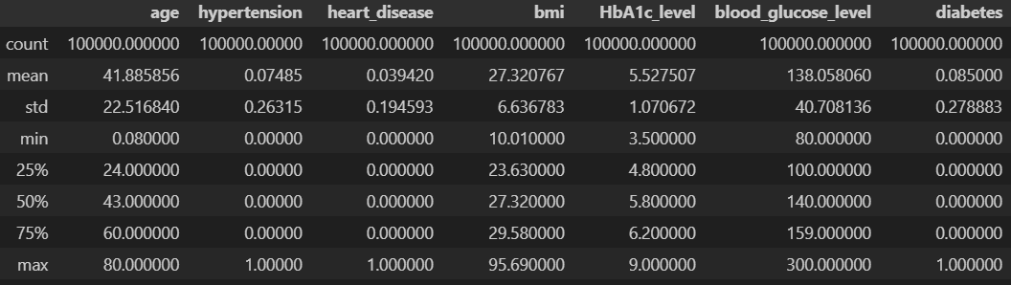
DATASET OVERVIEW
The means of most the columns are around 50%, with the maximum values spreading towards the right in the other quarters, suggesting the data is normally distributed and shows no signs of skewness.
However there is right skew in hba1c_level and blood_glucose_level

Slide 7
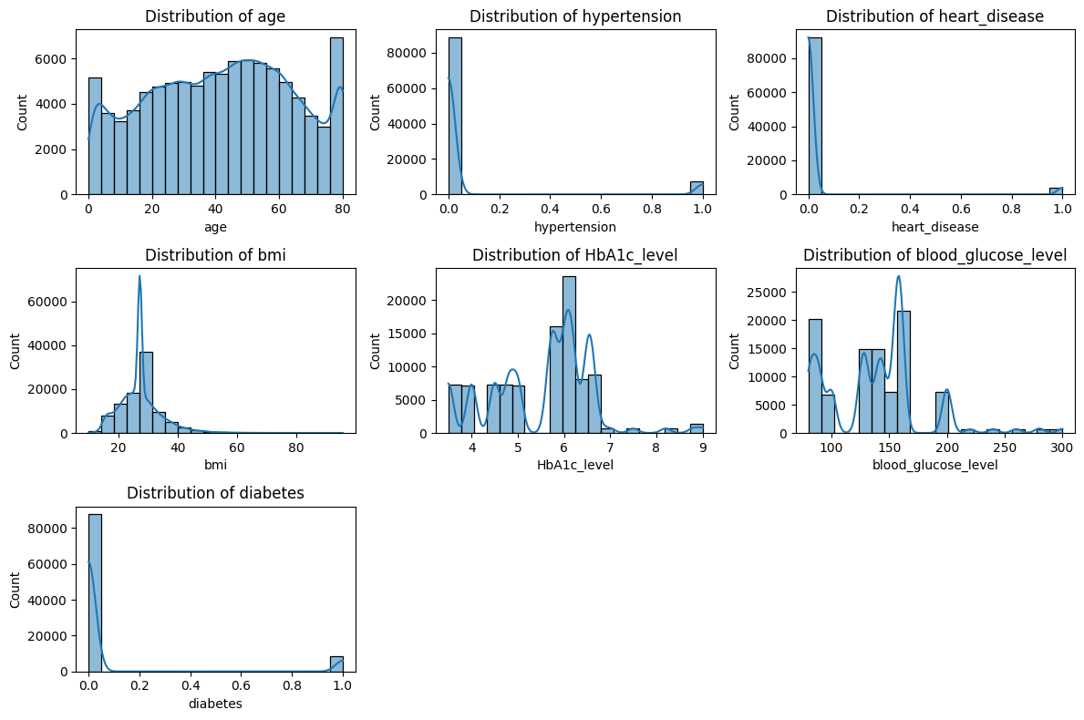
EDA
Numerical columns
The data is distributed normally enough except for age there is edge peak .
There is right skew in hba1c_level and blood_glucose_level.
Outliers in bmi

Slide 8
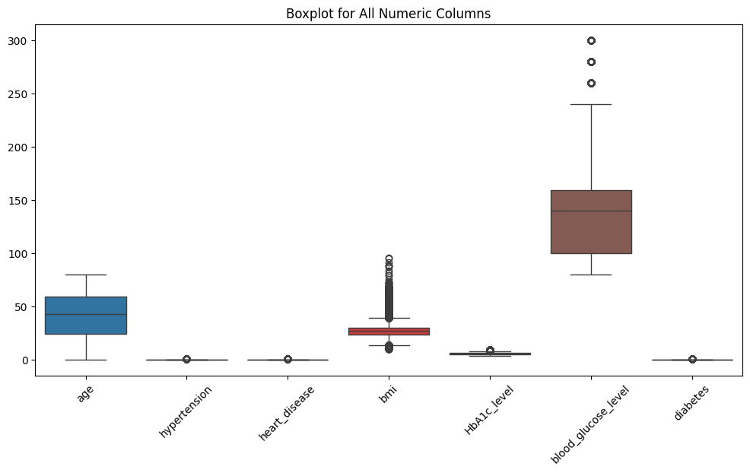
The box plot ensure the fact that there is an outlier in blood_glucose_level and bmi
But the outlier in HBA1C_level isn’t displayed that could because the values in the column is small

Slide 9
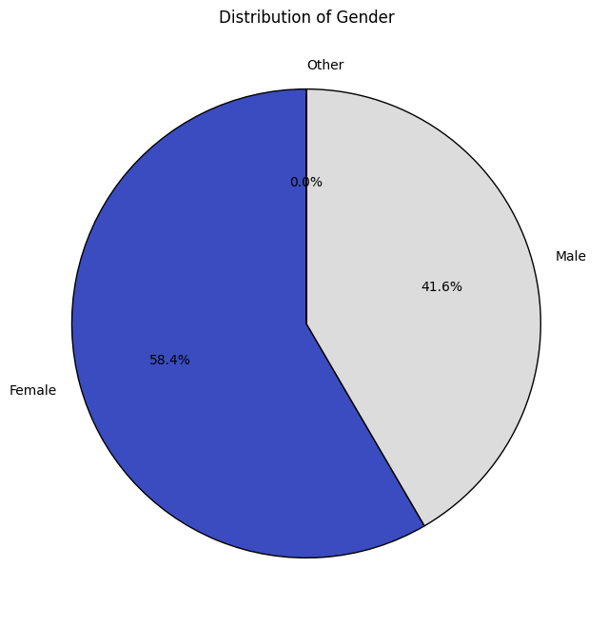
Most of the dataset is females by (56161) row, 39967 males

Slide 10
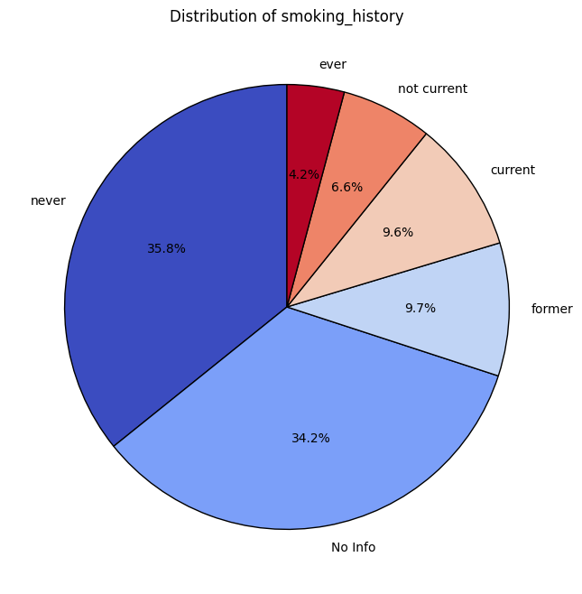
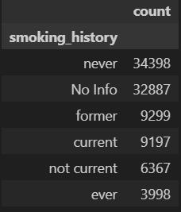
No info is the most 34.2 is missing
then never that could tell the data is biased towards non-smokers

Slide 11
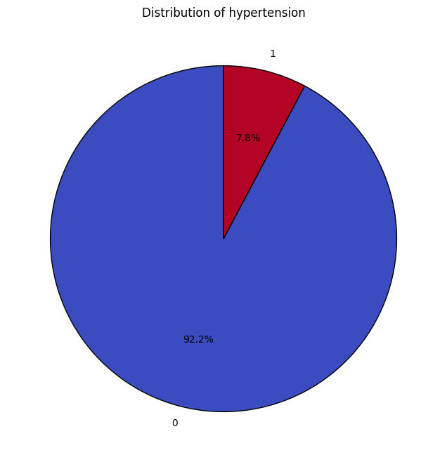
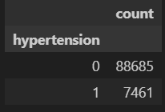
The data has great bias for patients without hypertension

Slide 12
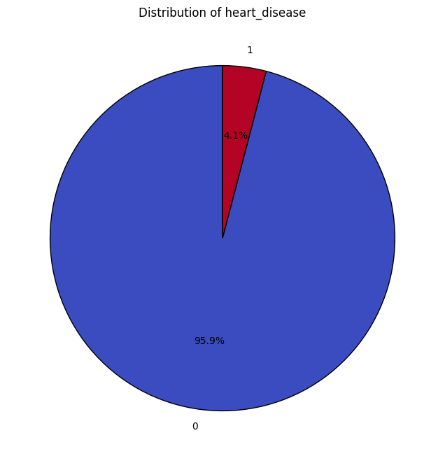
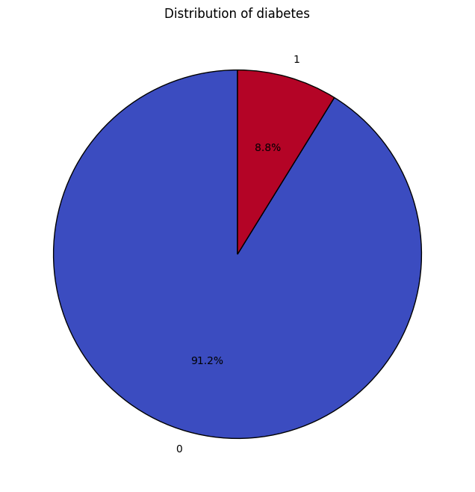
There is bias in all columns

Slide 13
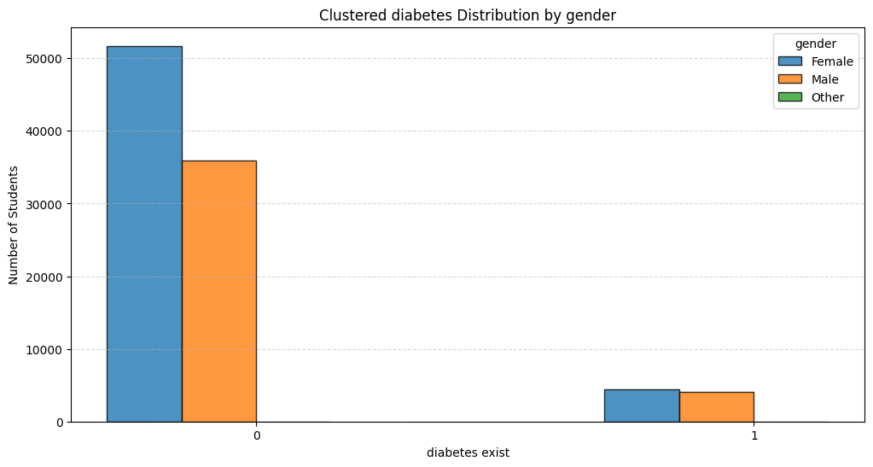
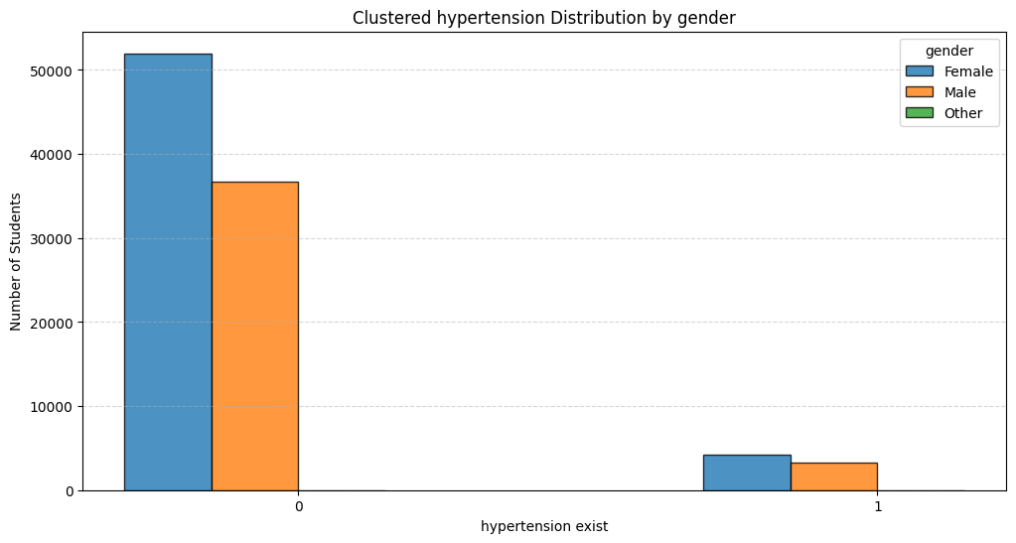
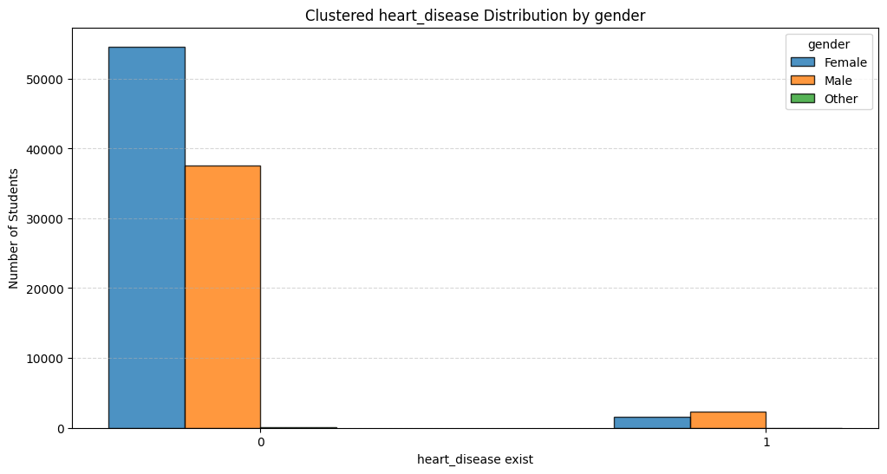
Most of the data are biased to the 0 that’s way it has higher values except that
Most of the females don’t have hypertension but the values are close in who have it
The same in diabetes
But in heart disease men has higher heart diseases

Slide 14
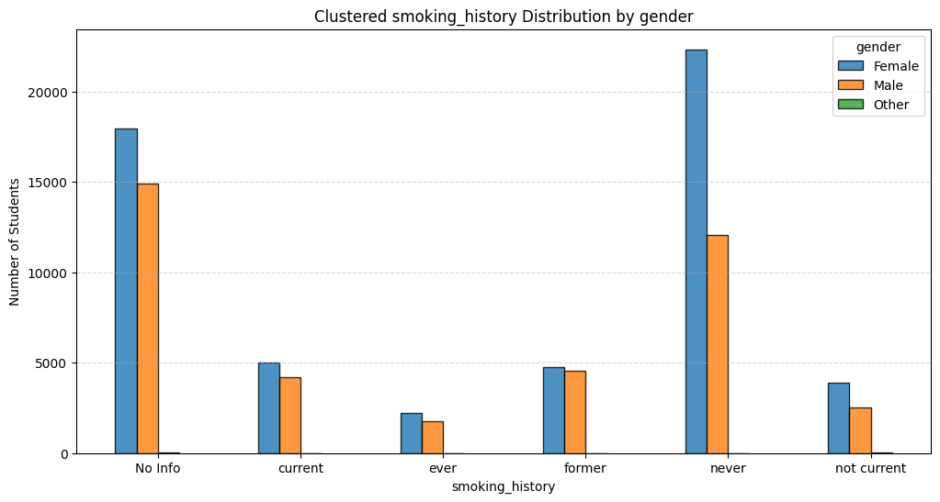
Most of the females never has smoked before.
In former the values all close and in current too
There is more females quit smoking

Slide 15
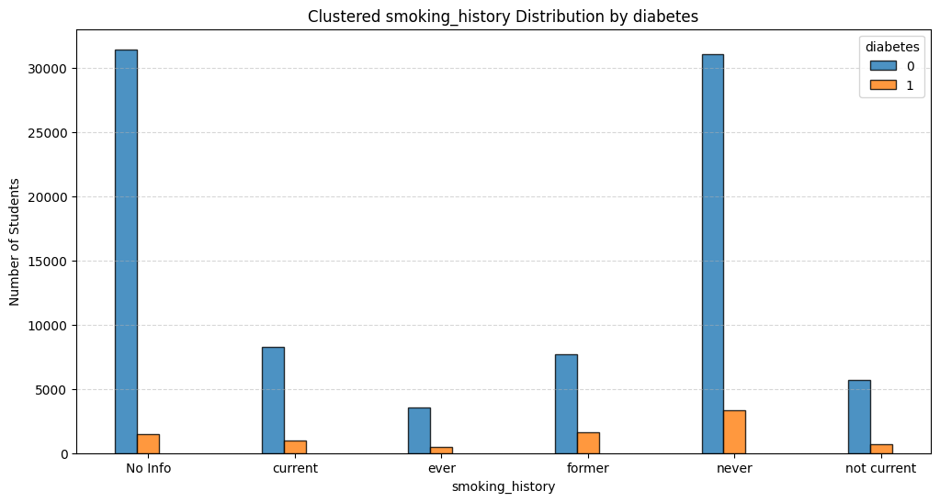
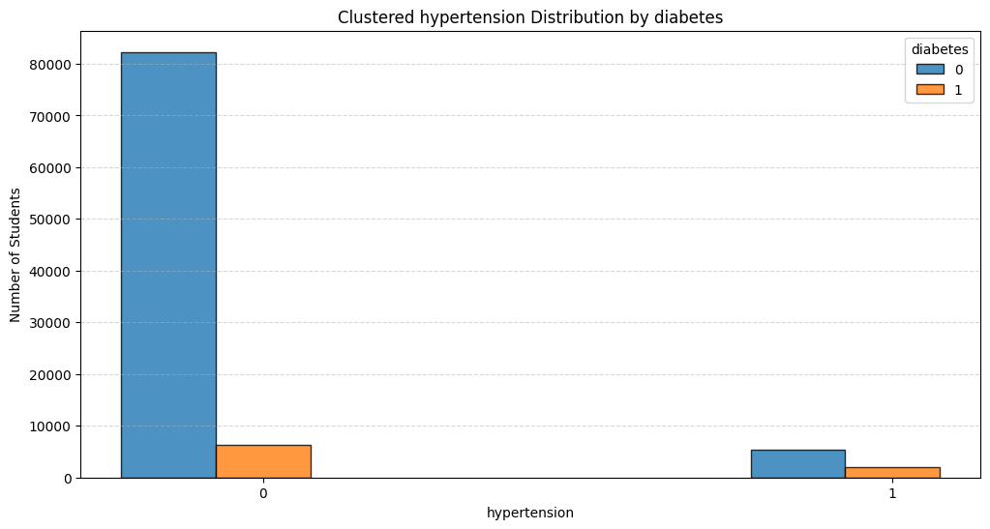
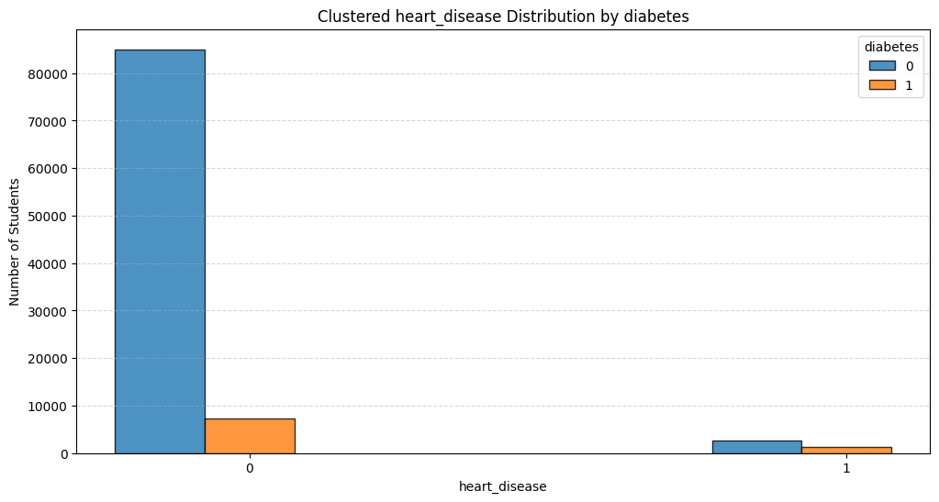
From the graph it shows that diabetes has weak correlation with smoking
Same with the other columns

Slide 16
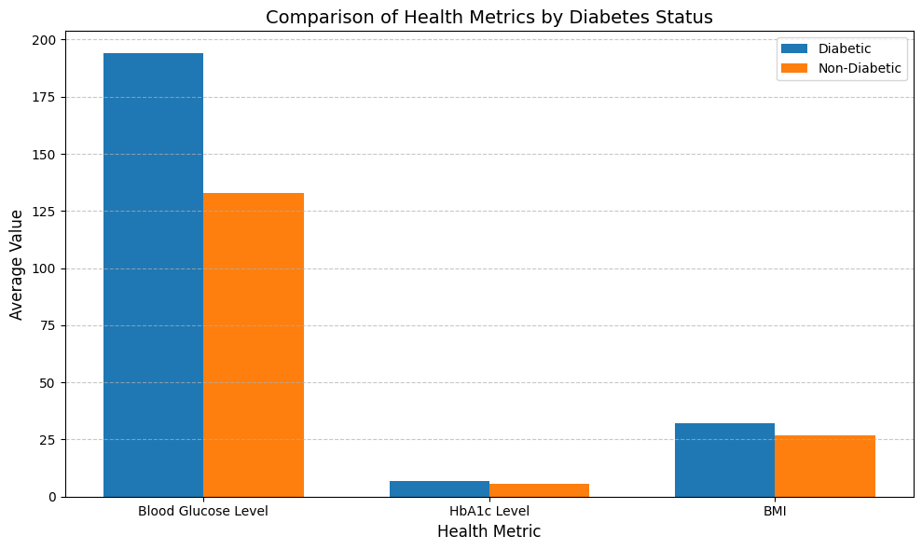
The blood glucose level has correlation with diabetes (and that the definition of the illness)

Slide 17
Balancing
After exploring the data it shows weak correlation and great bias
These two issues has great impact on the prediction because it leads the model to predict the category that its bias to better than the other one
Solve: Balances the training data using Random UnderSampling (removes samples from the majority class to match the minority class).
Then scaling the data using standard scaler the mean to zero and the variance is one

Slide 18
Metric | Precision | Recall | F1-score
Definition | Out of all predicted positives, how many are actually positive. | Out of all actual positives, how many are correctly predicted. | Harmonic mean of precision and recall.
Ideal Situation | High precision means fewer false positives. | High recall means fewer false negatives. | High F1-score balances precision and recall.
Use Case | Best when false positives are costly (e.g., spam detection). | Best when false negatives are costly (e.g., medical diagnoses). | Best when you need a balance between precision and recall (e.g., information retrieval).
Strengths | Focuses on minimizing false positives. | Focuses on minimizing false negatives. | Balances both precision and recall.
Weaknesses | May miss many true positives (low recall). | May incorrectly classify many negative samples (low precision). | Can be misleading if precision and recall are unbalanced.

Slide 19
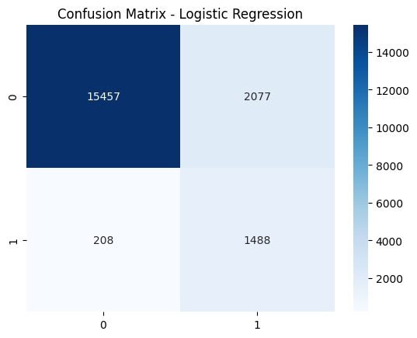
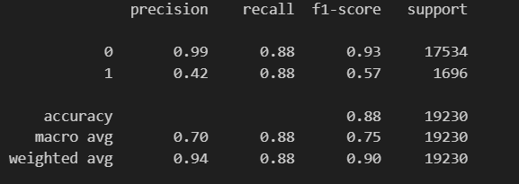
Modeling
Logistic regression:
is a supervised learning algorithm used for binary or multiclass classification.
The model did will in false negative and true positive
But it has higher values in false positive
In this case its better to tell the patient he/she has diabetes and he/she don’t have it than tell him/her she don’t have will he/she has it

Slide 20
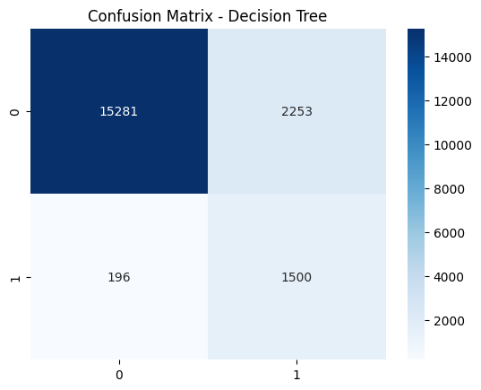
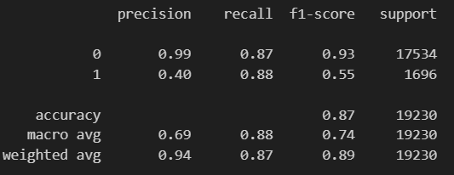
2. Decision Tree
It predicted less values at true negative, but the false positive and false negative is wrong

Slide 21

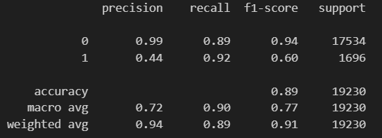
3. Random forest Lower TP , FP values
And better FN, TP

Slide 22

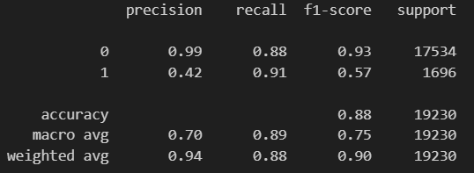
4. Svm:
Lower FN, TP, and TP
Higher FP

Slide 23
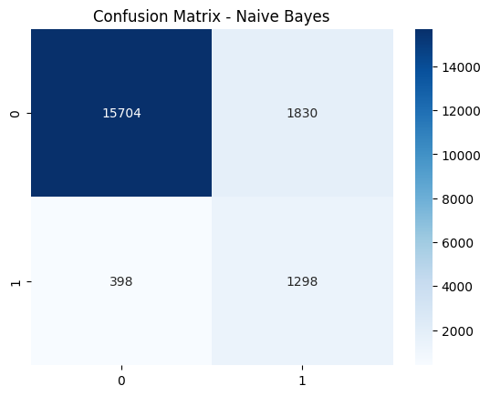
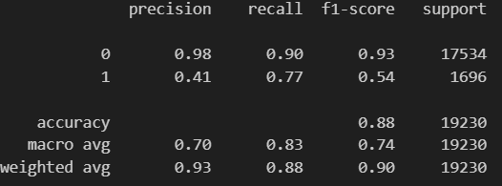

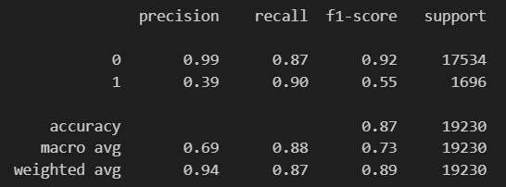
Naïve Bayes: has lower prediction and accuracy than knn

Slide 24

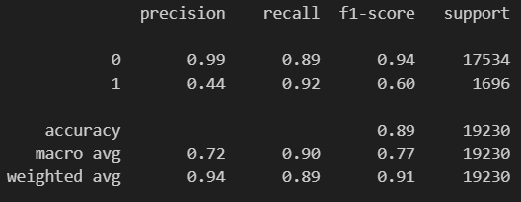

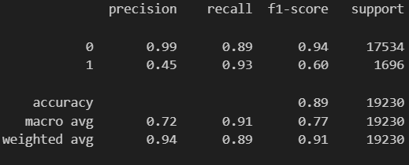
Xgboosting and light GBM has close score barely any deffrance
But xgboosting is better that’s because it can handle the bias better

Slide 25
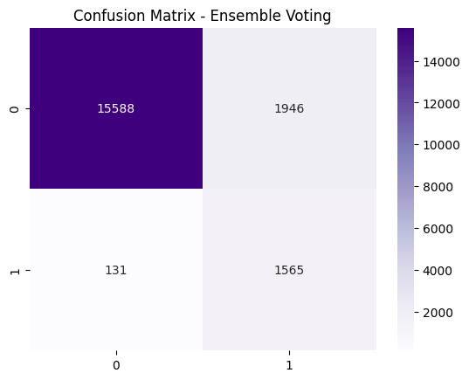
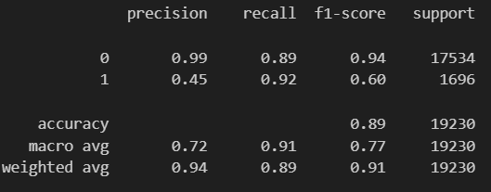
Ensemble voting
It has the best values overall

Slide 26
Thank You

